Slide 1
Raft consensus algorithm
Miulescu Cristina-Maria
SCPD

Slide 2

What is raft?
Distributed Consensus Algorithm
Alternative to Paxos
Leader-based
Ensures log replication

Slide 3
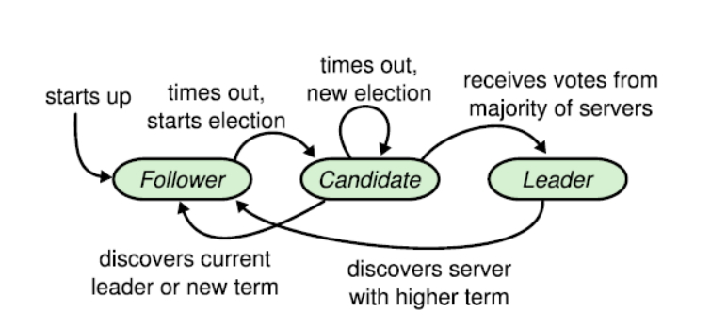
Main idea

Slide 4
IMPLEMENTATION
Server-Client
Log Manager
Raft Implementation

Slide 5
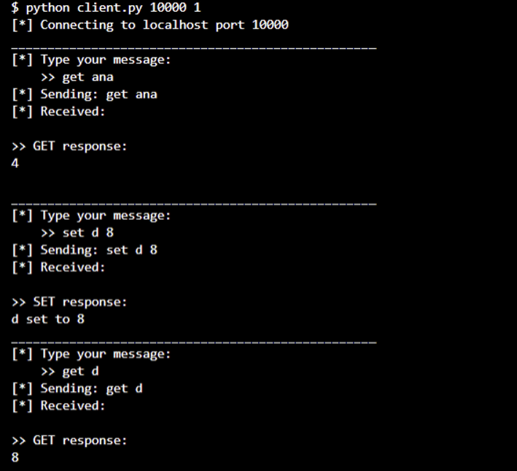
SERVER-CLIENT

Slide 6
LOG MANAGER
Execute
Execute commands from the client:
Keep
Keep track of each node’s logs
Get
Set
Delete
Show

Slide 7
Raft implementation
Append entries rpc
Request vote rpc
Leader:
Heartbeat messages
Replicate log entries
Current term
Previous term in log
Previous index in log
Candidate:
Request votes
Current term
Previous term in log
Previous index in log

Slide 8
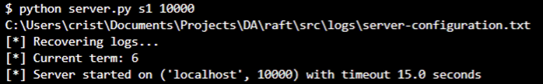
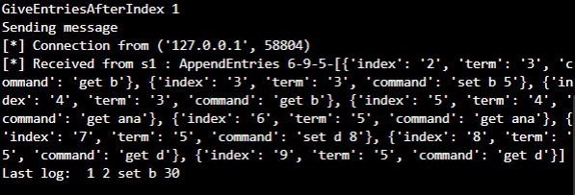
Follower
Recover logs
Receive append entries rpc

Slide 9
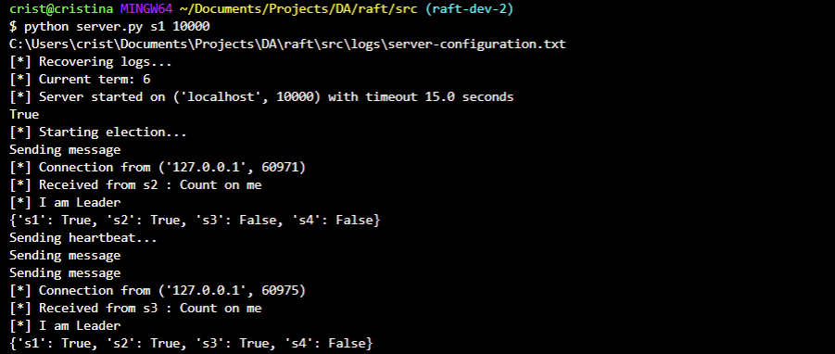
CANDIDATE

Slide 10
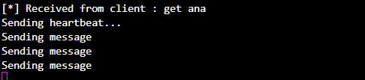
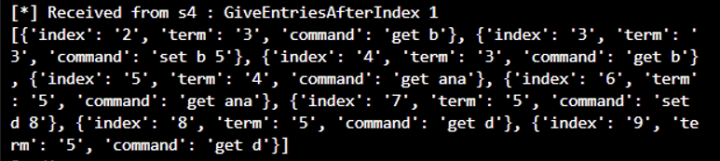
LEADER
HANDLE CLIENT CONNECTIONS
MAINTAIN LOG REPLICATION THROUGH HEARTBEAT

Slide 11
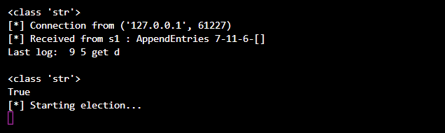
WHEN LEADER FAILS…

Slide 12
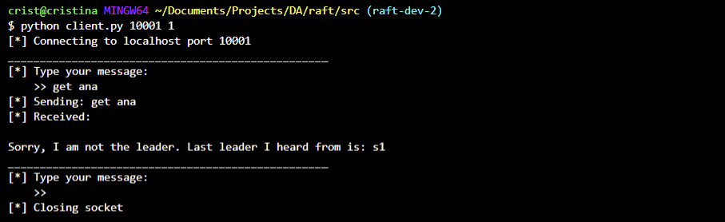
WHEN CLIENT CONNECTS TO A FOLLOWER…

Slide 13
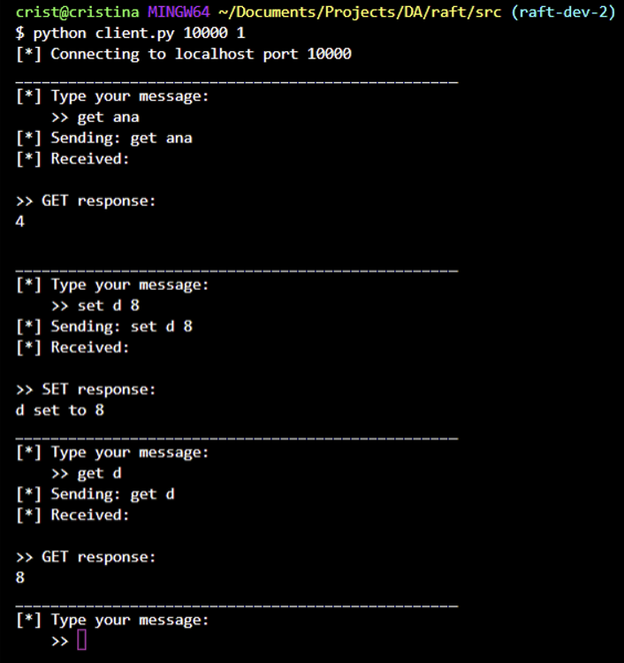
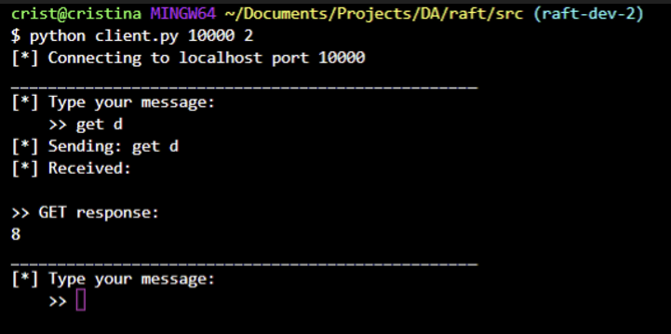
MULTIPLE CLIENTS

Slide 14
CONCLUSION
Main goal of the Raft Consensus algorithm is understandability which has been easily achieved during the implementation

Slide 15
Thank you

